Slide 1
Biomedical generative pre-trained based transformer language model for age-related disease target discovery
By Aarohi Chopra

Slide 2
Background

Slide 3
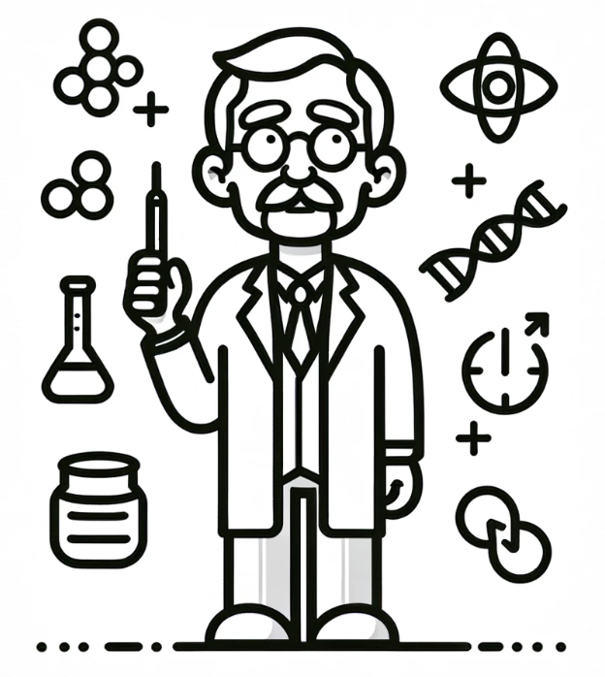


Motivation
Why
It’s complicated
Notes:
Understanding molecular mechanisms underlying such processes, molecular mechanisms associated with aging remain not well-understood
Aging is highly complex and multifaceted biological process, as it affects interrelated network of genes, proteins, and pathways implicated in aging process posing considerable challenges in traditional experimental and analytical methodologies
Why we use AI

Slide 4
Goal

Slide 5
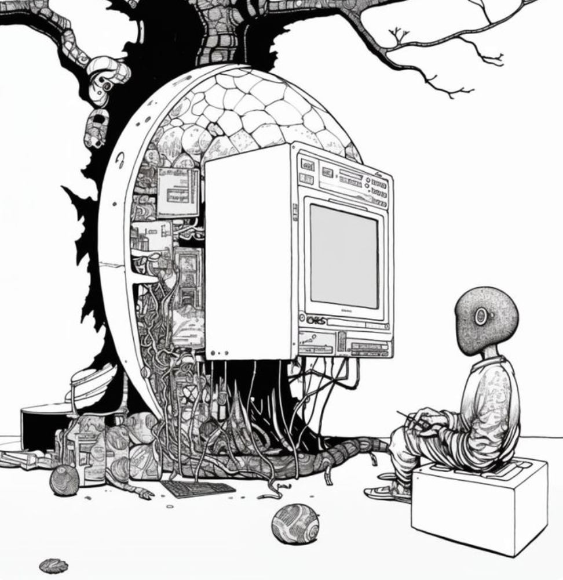
Large Language Models
1. LLMs?
2. Idea:
Next word prediction
3. Medical Context:
Disease to genes
Notes:
Algorithms trained on extensive datasets to understand and generate human-like text
Predicts next words on a probability distribution of context-aware words derived from previously fed data
Used for target prioritization of medical task with a matching objective and range the extracted targets
Target prioritization: medically important task with a matching objective is the target prioritization for a given disease.

Slide 6
Large Language Model Usage
1. Construct Prompt
2. Tokenize
3. Predict Gene

Slide 7
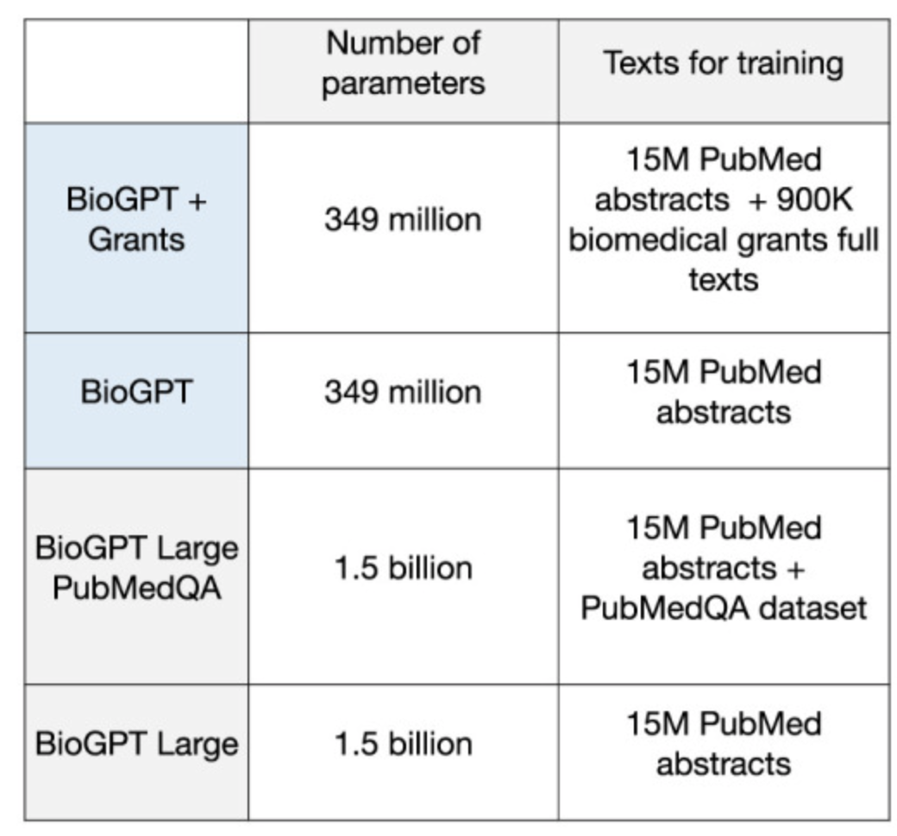
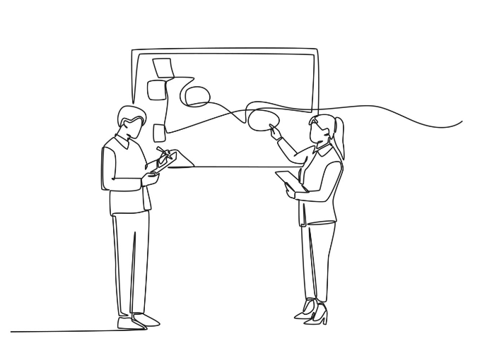
Data
Training Data:
National Institutes of Health Grants: 900 thousand
PubMed: 15 million
Reference Data
HUGO Gene Nomenclature Committee
GeneAge
ClinicalTrials.gov
DrugAge
PubMedQA
Notes:
There are a lot of databases and websites used for comparison, selection and understanding the data and it is important to mention them all initially so that they can be referenced back when we talk about them later

Slide 8
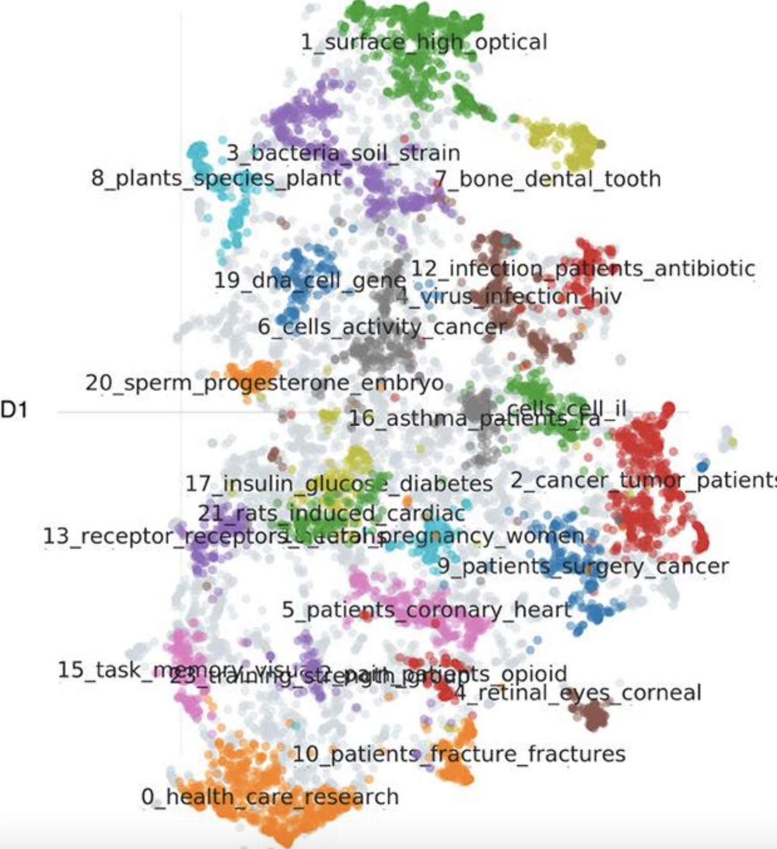
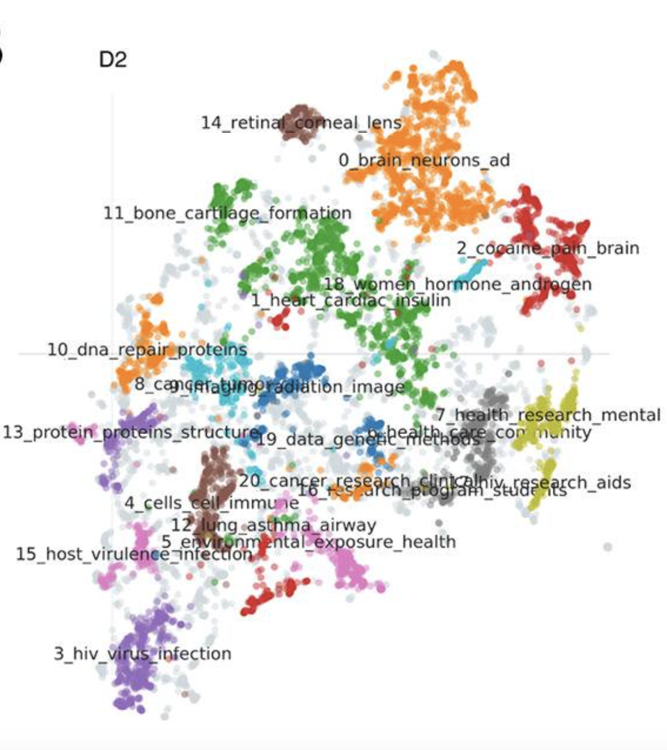
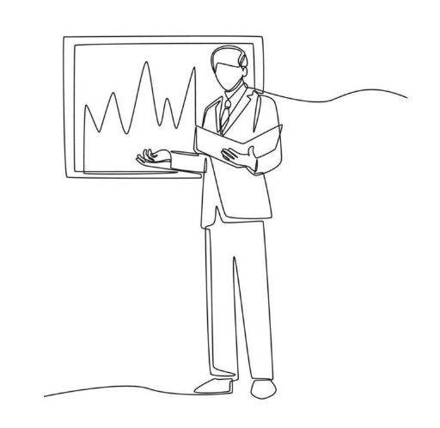
Exploratory Data Analysis
Grants
PubMed
BERTopic model was used to look at prevalent topics within PubMed and Grant texts.
Notes:
topics are indeed different between these two text corpus.
topics identified for grant proposals have appeared to be more relevant for target discovery
20 main topics identified for grants were closely related to human health and specific conditions or organs
PubMed text were more heterogeneous. Also, along with the human-related information, there were articles devoted to animal studies (topics 3, 8, 21) and other fields of Life Science

Slide 9
Methods

Slide 10
Embeddings
1. Sample: PubMed abstracts + grant texts
2. Processing: Lowercase + Removing stopwords(NLTK)
3. Embedding: “all-mpnet-base-v2” sentence-transformers model
Notes:
Random sample of 100 thousand publications was selected from the PubMed abstracts and grant texts for the following analysis.
Embeddings were retrieved with “all-mpnet-base-v2” sentence-transformers model
texts were pre-filtered by removing the stopwords with NLTK (Natural Language Toolkit) and converting text to lowercase format.

Slide 11
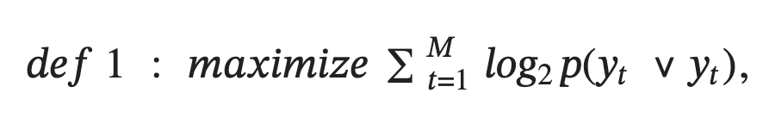
Training
1. Base: BioGPT (347 million parameters)pre-trained on 15 million PubMed abstracts
2. Task: Maximize log-likelihood of a next token given the context
3. Customize: BioGPT-G additional 900 thousand grant abstracts
4. Details:
Training time: 40 hours
Batch size: 16
Gradient accumulation step: 64 per device on four A5000 GPUs
Adam algorithm with 100 warm-up steps
Learning rate: 5e-5
Notes:
BioGPT model with 347 million parameters which is based on GPT-2 [69] medium size and pre-trained on 15 million PubMed abstracts
Training objective of this model aimed to maximize log-likelihood of a next token given the context
Biogpt-G Additionally pretrained more than 900 thousand grant abstracts with same objective as for GPT-2

Slide 12
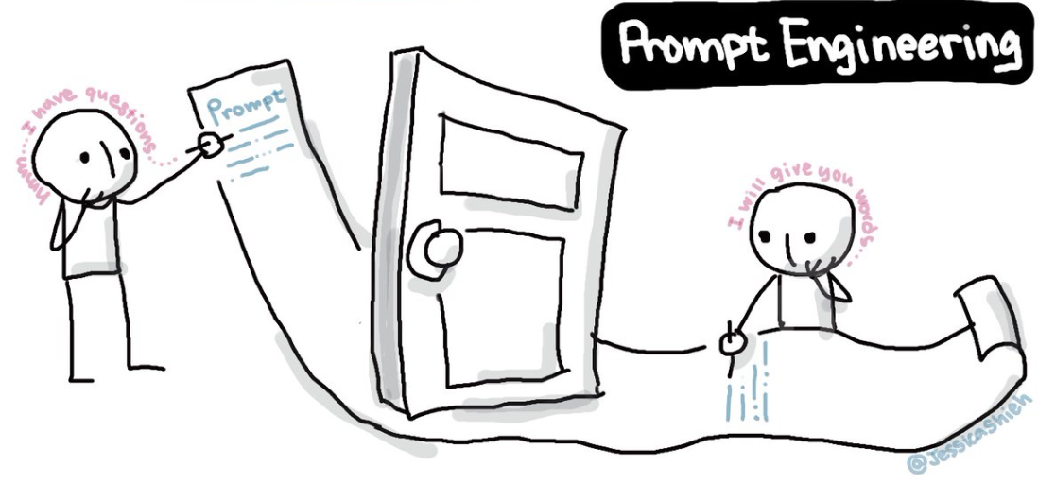
Prompt Optimization
Prompt: “Human gene targeted by a drug for treating {DISEASE} is”
2. Task: Next word prediction
3. Construction parameters settings
4. Efficiency Estimation
5. Findings:
Larger prompt length BAD
Addition of Articles GOOD
6. Brute Result: Total Prob_{Target Gene} = Multiplication of all tokens probabilities
Notes:
Task: Next word prediction
Construction parameters were tuned to increase the probability of the next word to be the abbreviation of a human gene
Efficiency Estimation: Efficiency of the prompt was estimated based on the number of genes found in the top 1K words ranged on the probability.
The Prompt was Human gene targeted by a drug for treating {DISEASE} is _______
Findings:
a) Larger prompt length negatively influenced the results b) The addition of Articles (“the” or “a”) at the end had the opposite effect.

Slide 13
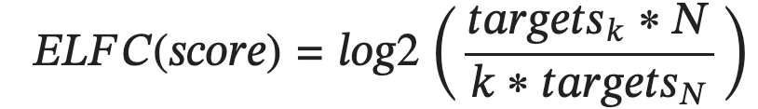
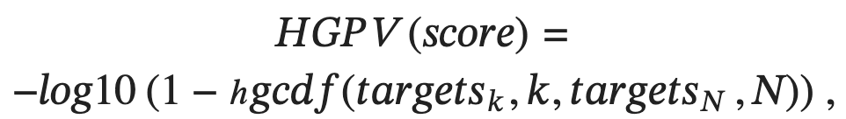
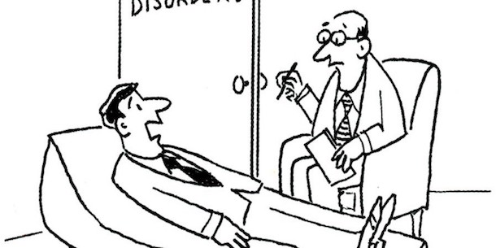
Validation
1. Analyze the top K values
2. ELFC - Log Fold Change of Enrichments (occurrence of targets relative to their general frequency the dataset)
3. HGPV - Hypergeometric p-value (Occur by chance or unusually high)
4. Higher values of ELFC and HGPV = GOOD
Notes:
top-k validation method was implemented/ The top-k gene list was evaluated on the effect strength and effect significance
prominently a certain target (like a protein related to aging) features within the most significant results (top-k) generated by a model, compared to how frequently it appears in the entire dataset
HGPV checks whether the findings from a sample are extraordinary or just due to random chance.

Slide 14

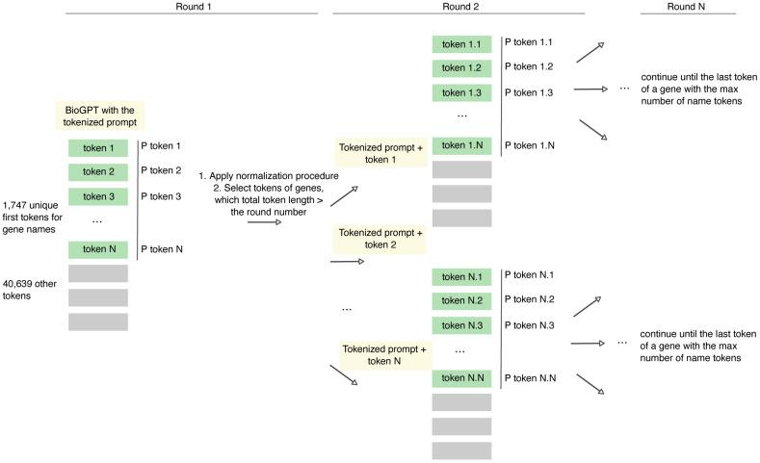
Tokenization: General Information
General Tokenizer: Microsoft for BioGPT
Vocab: Gene names in the vocabulary
Token Length: 2-7 tokens
Distribution: Less than 2% of the genes are in the vocab
Probability Calculation: Tokens are iteratively added to the initial prompt in the next token probability
Notes:
general tokenizer provided by Microsoft for BioGPT
part of the gene's names in the vocabulary
less than 2% of the genes are directly found in the vocabulary
genes are coded with 2 to 7 tokens
probability of the gene name with several tokens, the tokens were iteratively added to the initial prompt for the calculation of the next token probability

Slide 15
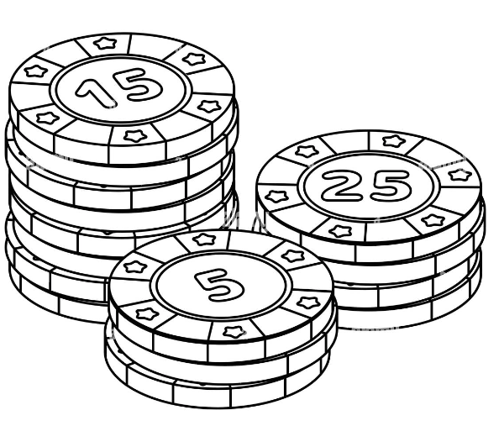
Processing Tokenization
1. Maximum token limit
2. Filtering longer genes
3. Prevent skew for abundant non-gene data
4. Use cases (based on token length) A. Gene length <= iterations(N) B. Gene length > iterations(N) 5. Varying gene length normalization (separate and combined)
6. Normalization of Final Probabilities with longer lengths
Notes:
Maximum Token length was selected based on the based on most common genes in the training set
The target gene length was between 1-5 so they filtered out all the genes which had token length greater than 5
Only few of the whole vocab is gene names so to prevent skewing from non gene data all of the tokens were divided by total probability of all gene tokens
Token length can differ among different target genes so they decided to apply normalization A. Normalizing each token (part of the gene name) in every step of the analysis. B. Normalizing the combined probabilities for all gene tokens at the end of the process.
As we talked about token limits and lengths in the beginning if the beginning we can have 2 cases
a) the gene length was computed <= iterations of token computation
b) or it was more than that and the model had to squeeze the tokens into one or more iteration to finish the prompt The ways to normalize the above cases had to handle whether the gene normalization was simple separate sum(case 1) or (possibly by combining the processing of several tokens in a single round or by extending the number of iterations in some way to accommodate all tokens.)
Adjusted this by dividing the total probability by the length of the gene name to mitigate this issue.

Slide 16
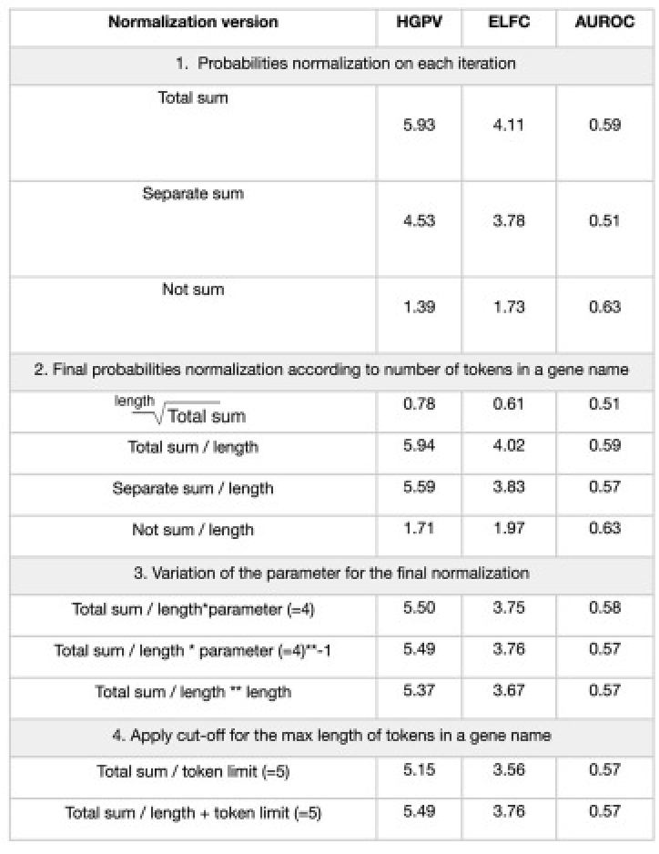
Results
1. Product/token length (Figure C 1.3 & 2.4)
2. Normalizing individual tokens(each iteration) given ∑_{all tokens} = 1 (Figure C 3.1)
3. Parameter selection
Notes:
Dividing the final probability of longer gene names with the length of gene name/token increased the accuracy
During Normalization of the individual tokens in each iteration when sum of all gene tokens equals to 1 has shown the best performance
While selecting best parameter for final normalization. The results suggested that parameter does not significantly affect the performance, however parameter equals to 1 yields slightly better results
The results have shown that the model that involved the full list of genes, normalization to 1 on each interaction, and the normalization of the final product by the division of the name length outperforms other model versions

Slide 17
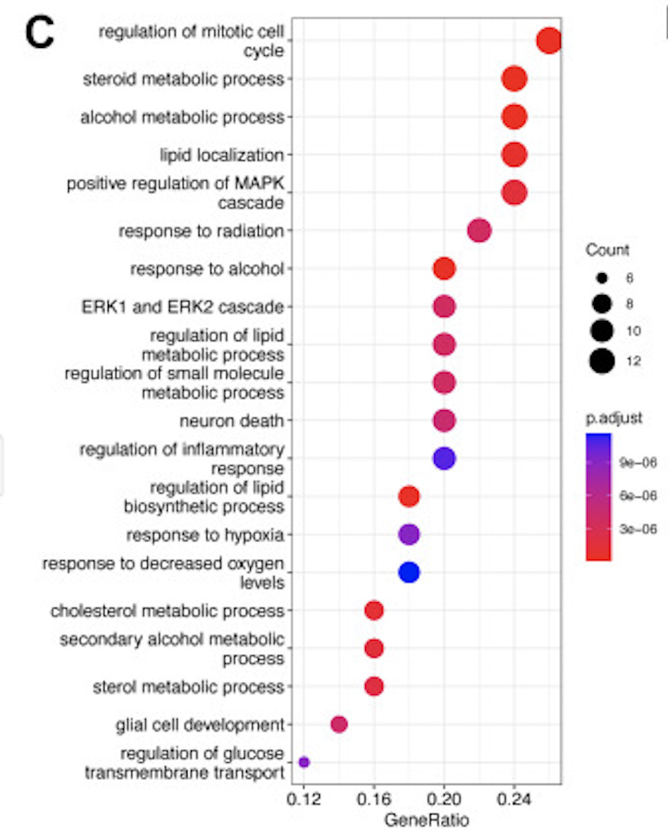
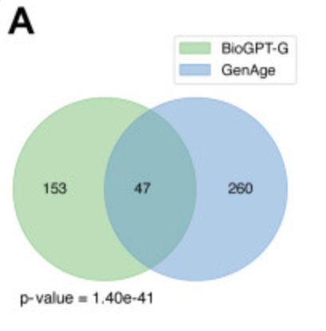
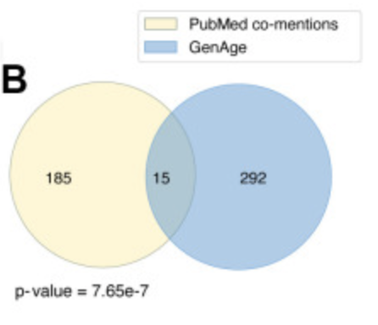
Target Discovery for Aging
1. Top 200 genes were selected
2. ∩ GenAge database (p < 0.001)
3. ∩ PubMed database (p < 0.001)
4. Gene Ontology (GO) enrichment analysis (FDR adjusted p < 0.01)
Notes:
For analysis the paper looked at top 200 genes were extracted from the BioGPT g model
Those results were compare during intersection with GenAge database (p < 0.001)
The 200 samples were also Intersected with PubMed database (p < 0.001) where the most commonly mentioned genes in the context of aging were selected by calculating the number of abstracts with the co-occurrence of the selected gene name and “aging”.
For these top 50 genes, significant associations were found in 575 different categories. The significance of these results is statistically confirmed, with a False Discovery Rate (FDR) adjusted p-value of less than 0.01.

Slide 18
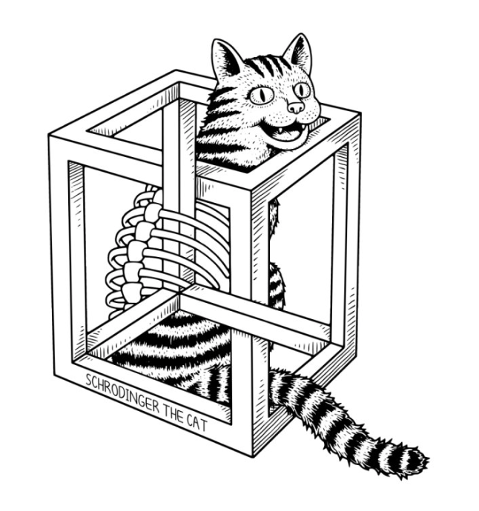
LLM Explainability
1. Task: Protein Embeddings and graphs
2. Hypothesis: Learn not only probabilities also internal associations of word similarities
3. Result: Protein [pubmed(~ aging) and BioGPT(aging)] ---- Protein [pubmed(aging) and BioGPT(aging)]
Notes:
Constructed the graph with vertex weights corresponding to cosine similarities between protein nodes
BioGPT learns not only the probabilities of the words in the specific context, but also creates the internal associations of word similarities
When compare with the other proteins: nodes corresponding to the proteins, which are not highly mentioned with “aging” in PubMed texts but selected as age-related by BioGPT, placed closer on the graph to the proteins both co-mentioned with “aging” and selected as age-related by BioGPT

Slide 19

Protein Graphs:
1. "The human age-associated gene is the" gene name —> Tokenized_{mean output pooling} ___—> PyTorch tensor₁₀₂₄ —> Individual proteins
2. Source Nodes: Proteins in (PubMed abstract co-mentions) AND (BioGPT aging)
3. Target Nodes: Pro(BioGPT aging) & NOT(PubMed abstract co-mentions)
4. Random Nodes: Random proteins for main experiment and control values
Notes:
A tensor vector was created by using the prompt "The human age-associated gene is the" gene name. This prompt was tokenized using, mean output pooling was used and then was converted into a pytorch tensor of size 1024 which was used as individual token

Slide 20
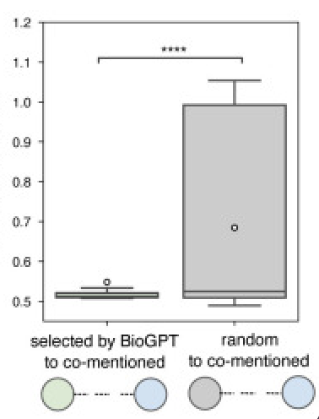
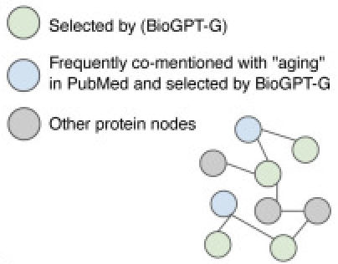
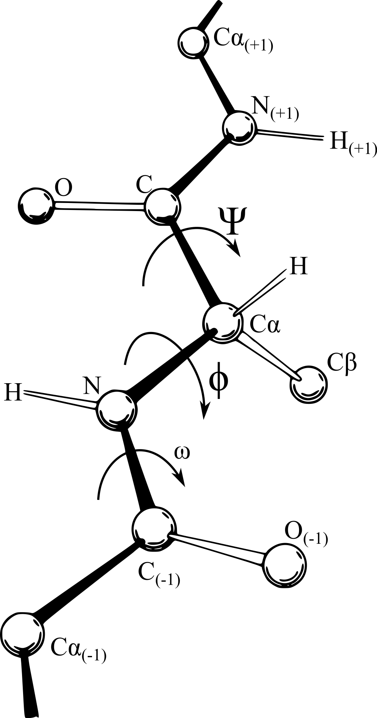
Graphs Continued
1. Weighted Undirected Graph was constructed with NetworkX
2. Protein Similarity: Cosine Similarities between the nodes, cut-off of 0.507
3. Dijkstra’s algorithm
Notes:
They used cosine similarity to compute the similarity between the protein nodes and set the cutoff to 0.507 to preserve only relevant connections
They used Dijkstra’s to compute the shortest distance

Slide 21
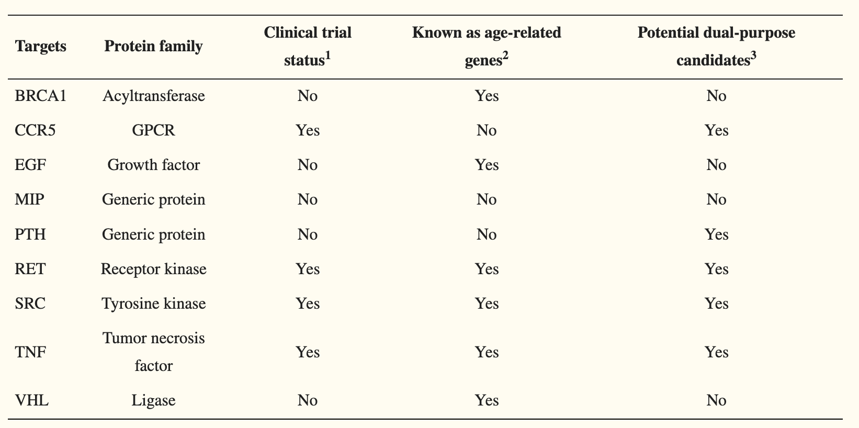
Dual-purpose Disease and Age-Related Targets
1. Top 200 genes for 14 age related diseases^{1.}
2. 200*14 genes ∩ BioGPT age-related search
3. 9 genes common for all of 14 diseases and aging
4. 9 obtained genes: BRCA1, CCR5, EGF, MIP, PTH, RET, SRC, TNF, &VHL
Notes:
Targets not considered as potential dual-purpose candidates were due to either (1) tumor suppressor properties or (2) opposite direction of therapeutic approaches between aging and age-related diseases.
https://pubmed.ncbi.nlm.nih.gov/35347083/

Slide 22
Discussion
1. Novel: CCR5, MIP, and PTH (Previous Table)
2. After filtering TNF, SRC and RET, and two novel genes, CCR5 and PTH
3. TNF -> Age associated inflammation
4. SRC -> Targeted by Dasatinib(Senolytic)
5. RET -> Higher levels causes thyroid cancer + Increases with age
6. CCR5 -> Neuroinflammation + Alzheimer's disease
7. PTH -> Osteoporosis + Frailty
Notes:
Among these 9 genes, CCR5, MIP, and PTH are considered as novel age-related targets because their roles in aging were not reported previously based on the databases for experimentally validated age-related genes and compound
MIP is a candidate tumor suppressor so are BRCA1 and VHL. Why dont consider those: targeting these tumor suppressors could be attributed to the increased risks of cancer development
After filtering out the targets due to the limitations mentioned before finally TNF, SRC and RET, and two novel genes, CCR5 and PTH are considered potential dual-purpose candidates for aging and age-related diseases

Slide 23
References
https://pubmed.ncbi.nlm.nih.gov/30269508
https://pubmed.ncbi.nlm.nih.gov/36936271
https://pubmed.ncbi.nlm.nih.gov/35837482
https://pubmed.ncbi.nlm.nih.gov/32534441
https://www.ncbi.nlm.nih.gov/pmc/articles/PMC10564439/

Slide 24
Thank You :)

